Slide 1


Data Science Mini Project
Analysis and Forecasting of Commodity Exports to European Countries
Tarun Kumar Singh
Sem: 7ᵗʰ
Under the guidance of
Dr. Piyush Chauhan
Symbiosis Institute of Technology, Nagpur Campus
1

Slide 2


Understanding the Business Problem
Analyzing complex export patterns across European markets requires turning massive raw trade data into meaningful insights. Europe is a key player in global trade, with strong demand across various commodity sectors.
This study explores export trends to European countries — focusing on product categories, transaction volumes, and monetary flows — to identify key revenue drivers, price variations, and temporal trade patterns.
These insights will form the foundation for predictive models that forecast future export volumes and values.
2

Slide 3

Data Source
The dataset originates from India's Directorate General of Commercial Intelligence and Statistics, available through the Government of India Data Portal. It encompasses comprehensive trade metrics including commodity values in both USD and INR, transaction quantities, and detailed classification codes.
Initial Scale: 2,690,579 records across 15 columns
Post-Cleaning: 330,610 high-quality records
License: Open Government License - India
3

Slide 4
Project Goals
1. Data Preparation: Clean and structure large-scale export dataset
2. Exploratory Analysis: Identify key trends and patterns
3. Predictive Modeling: Build ML models for value and category prediction
4. Interactive Deployment: Launch Streamlit web application
4

Slide 5
Data Processing Methodology
Data Cleaning: Handling missing values and correcting data types, including date conversion for time-series analysis
Feature Engineering: Extracting Year, Month, and Quarter from dates to enable temporal pattern analysis
Analysis & Visualization: Leveraging Python libraries for comprehensive data exploration
5

Slide 6
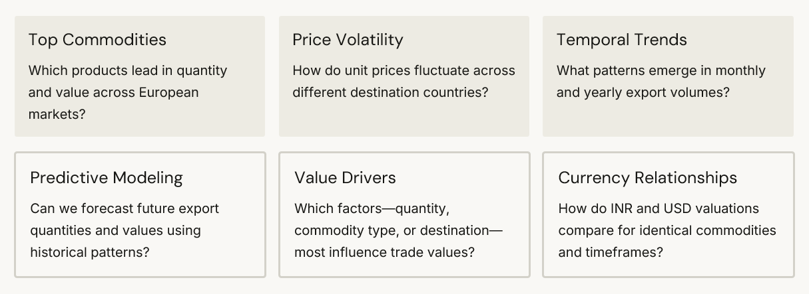
Key Research Questions
6

Slide 7


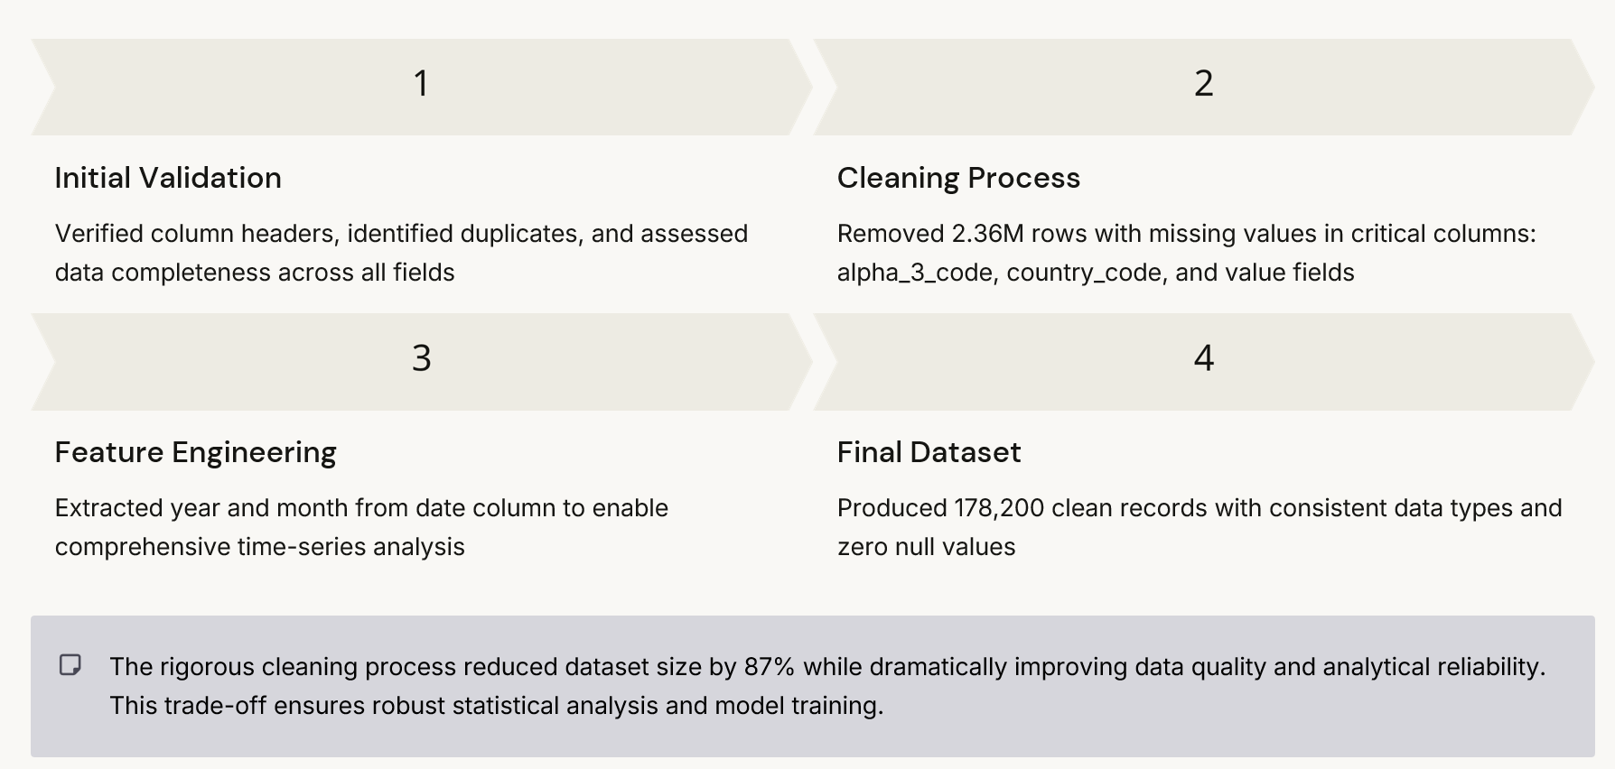
Data Preparation and Quality Assurance
7

Slide 8
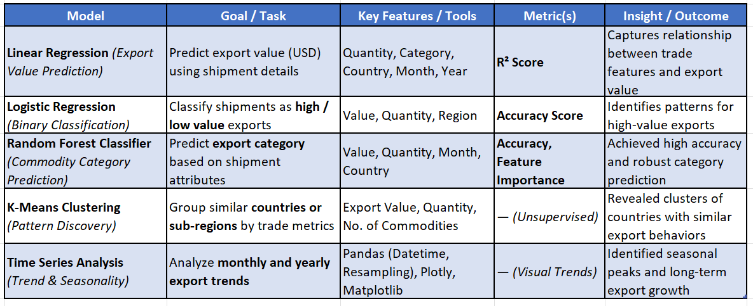
Machine Learning Models Summary
8

Slide 9

Key Insights and Strategic Recommendations
Critical Findings
Commodity Leaders: Automotive diesel fuel, aviation turbine fuels, textiles, and agricultural products dominate export portfolios
Geographic Concentration: UK, Germany, and Albania represent top destinations by monetary value
Growth Trajectory: Clear upward trend in total export values indicates expanding European market opportunities
•Price Dynamics: Significant unit price variations across countries suggest opportunities for market-specific pricing strategies
Strategic Actions
  Prioritize High-Value Markets: Strengthen relationships with UK and Germany while exploring emerging European markets
  Diversify Portfolio: Expand beyond fuels and textiles into electronics, machinery, and medical equipment sectors
  Leverage Predictive Analytics: Deploy forecasting models for demand prediction and supply chain optimization
  Segment-Specific Strategies: Develop tailored approaches for each commodity cluster identified through K-Means analysis
9

Slide 10
Tech-Stack
  NumPy: Numerical computations and matrix operations
  Pandas: Data manipulation and analysis
  Scikit-learn: Machine learning models (Regression, Classification, Clustering)
  Seaborn: Statistical data visualization
  Matplotlib: Data plotting and graphing
  Plotly: Interactive and dynamic visualizations
  Streamlit: Building interactive data dashboards
  Warnings: Manage and suppress warnings
  Datetime (via pandas): Handle and process time-series data
10

Slide 11

Thank You
11

